Slide 1
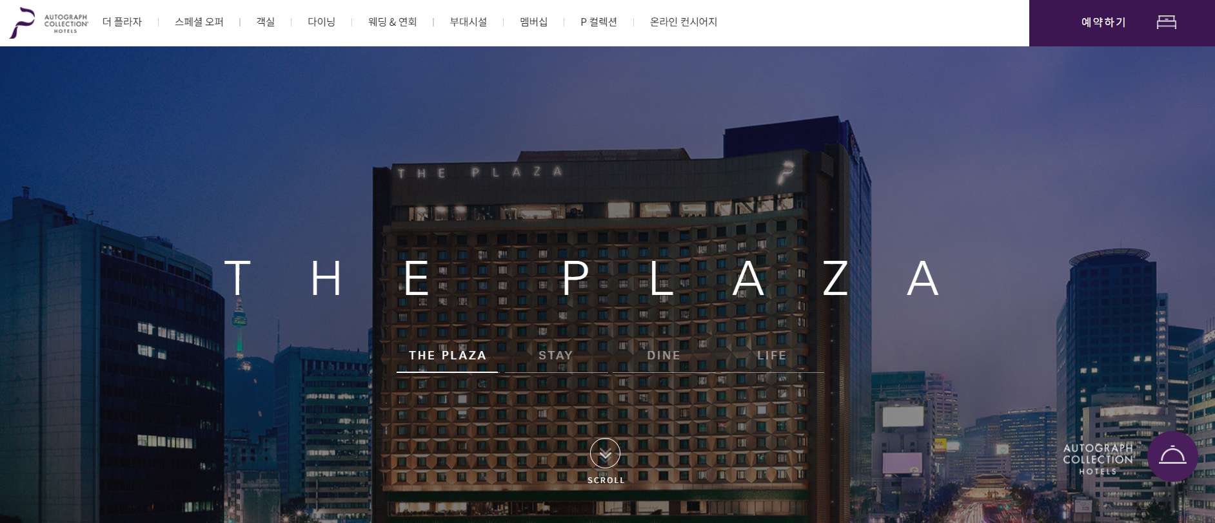
Building Hotel System
based on real scenario
includes four promos
used mock database
object-oriented code
manage directory structure properly
TEAM 2
김민균 염수지
이현정 허유미

Slide 2
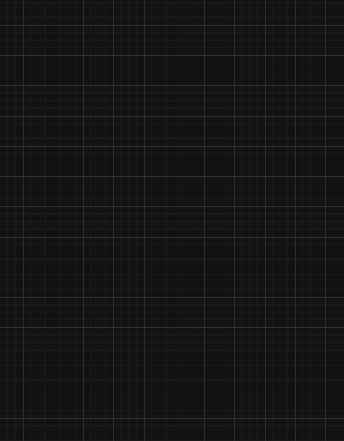
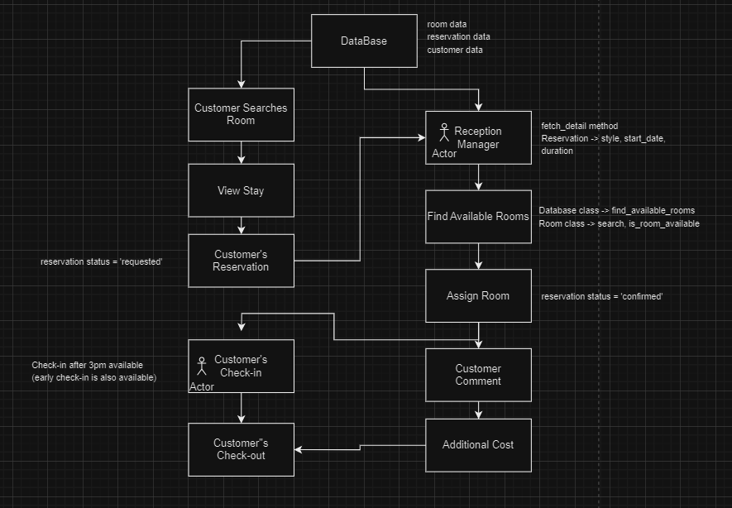
DIAGRAM
<Directory>
Team2_Hotel_System/
├── admin_system/
│ ├── models/
│ │ ├── customer.py
│ │ ├── invoice.py
│ │ ├── reservation.py
│ │ ├── room.py
│ ├── utilities/
│ │ ├── database.py
│ │ ├── promotion.py
│ ├── __main__.py
├── customer_system/
│ ├── models/
│ │ ├── customer.py
│ │ ├── reservation.py
│ │ ├── room.py
│ ├── utilities/
│ │ ├── database.py
│ │ ├── promotion.py
│ ├── __main__.py
├── reservations.JSON
├── rooms.JSON
├── users.JSON

Slide 3
DIAGRAM
Team2_Hotel_System/
customer_system/
admin_system/

Slide 4
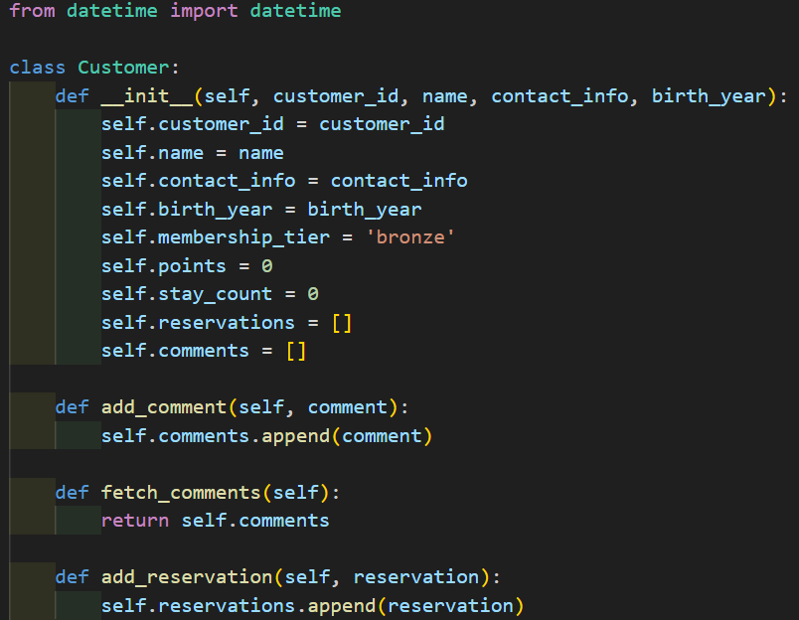
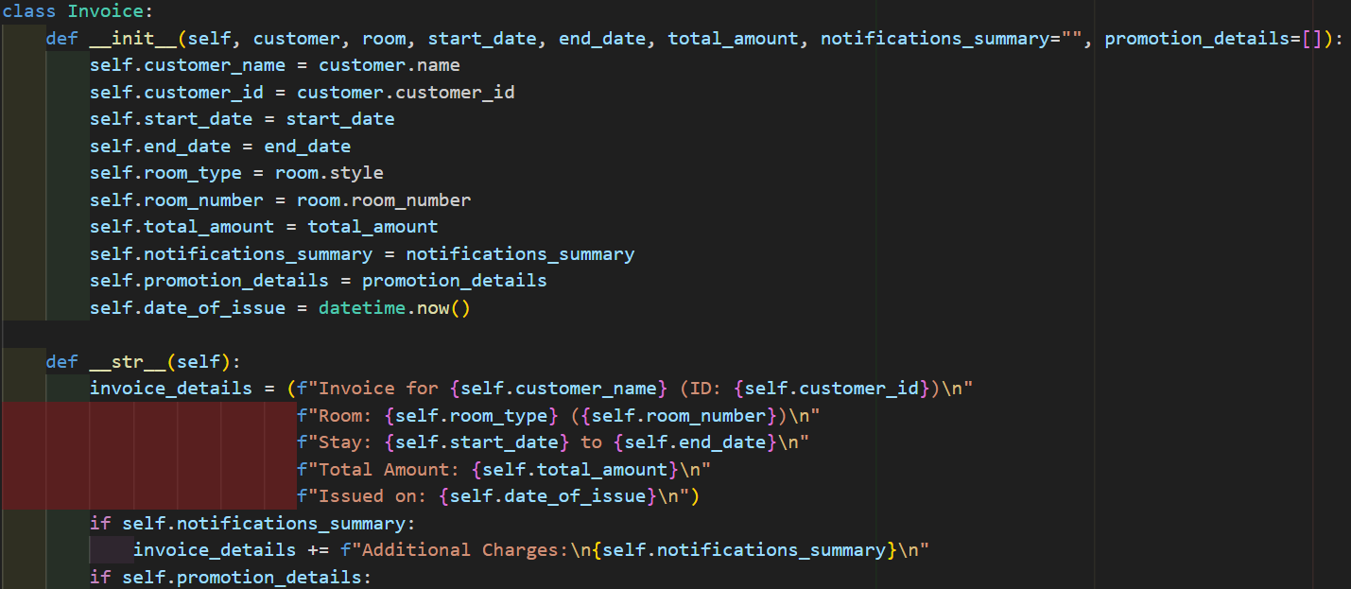
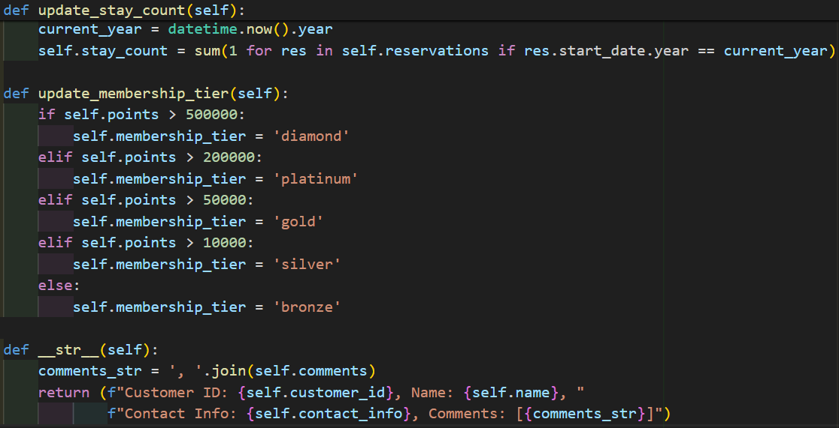
├── admin_system/
│ ├── models/
│ │ ├── customer.py
│ │ ├── invoice.py
│ │ ├── reservation.py
│ │ ├── room.py
│ ├── utilities/
│ │ ├── database.py
│ │ ├── promotion.py
│ ├── __main__.py
<customer.py>
manage all of the customers' information.
<invoice.py>
invoice for customers' checking in/out.
customer's name, membership number, date, room type, ...

Slide 5
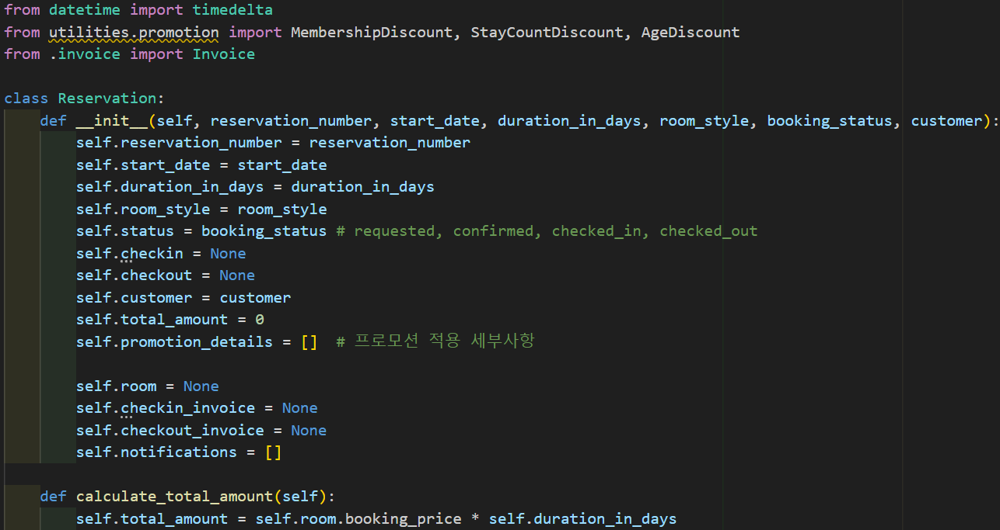
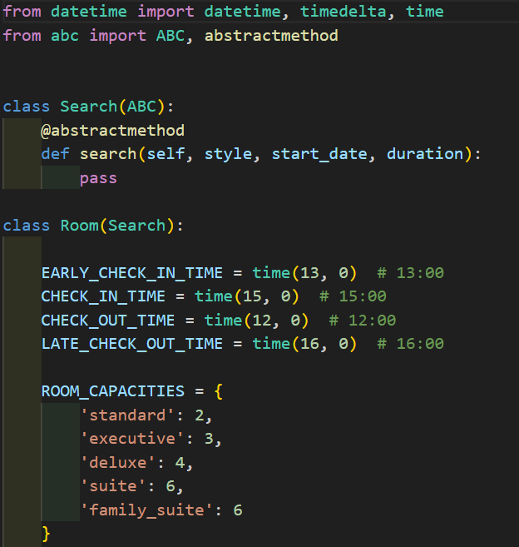
├── admin_system/
│ ├── models/
│ │ ├── customer.py
│ │ ├── invoice.py
│ │ ├── reservation.py
│ │ ├── room.py
│ ├── utilities/
│ │ ├── database.py
│ │ ├── promotion.py
│ ├── __main__.py
<room.py>
check-in/out time set
room info
room status: ready, housekeeping, check-in, …
early check-in, late check-out are available
<reservation.py>
apply promotion
calculate total amount
assign room
notification…etc

Slide 6
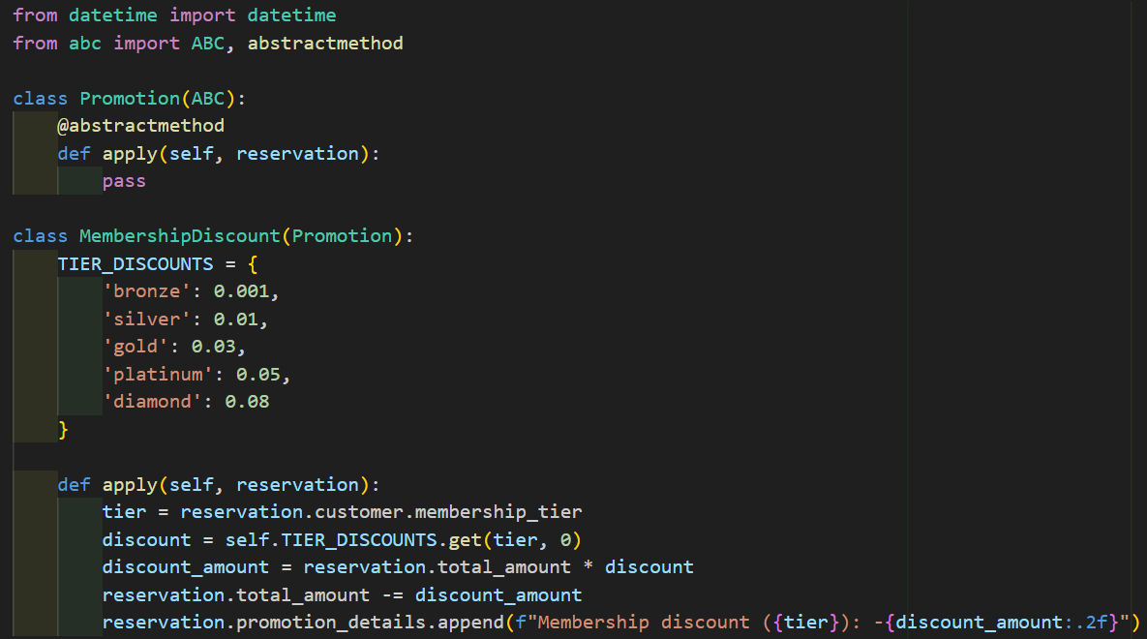
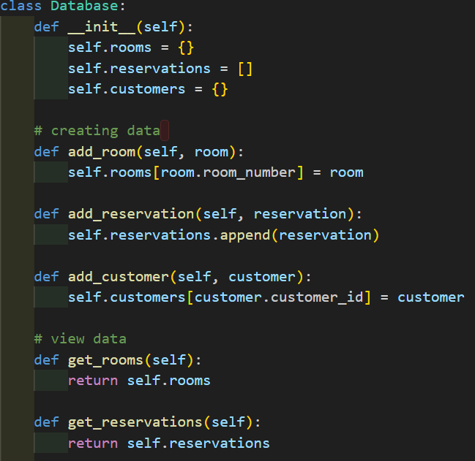
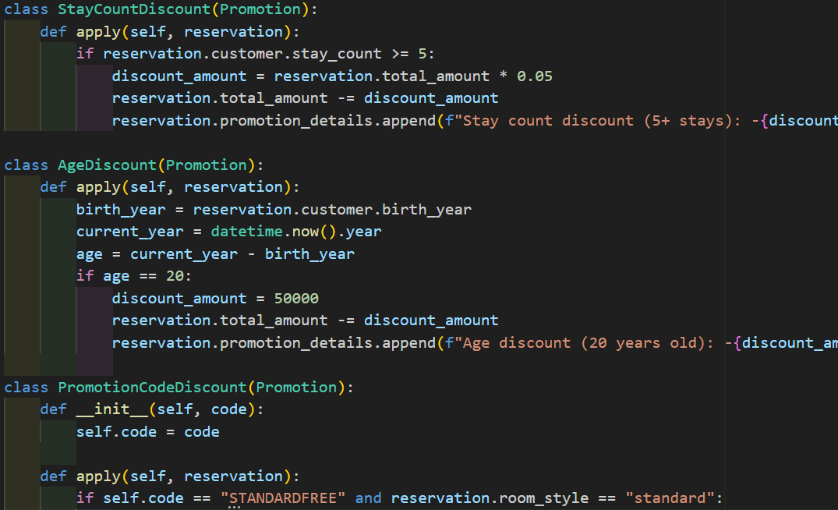
├── admin_system/
│ ├── models/
│ │ ├── customer.py
│ │ ├── invoice.py
│ │ ├── reservation.py
│ │ ├── room.py
│ ├── utilities/
│ │ ├── database.py
│ │ ├── promotion.py
│ ├── __main__.py
<promotion.py>
1. Membership discount
2. Stay count discount
3. Age discount
4. Promotion code discount
<database.py>
create, view, search

Slide 7
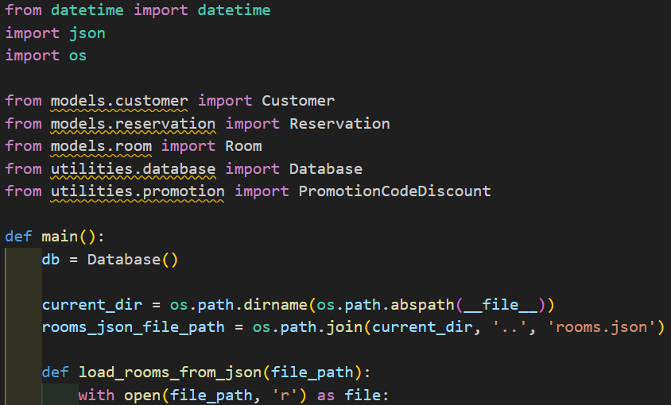
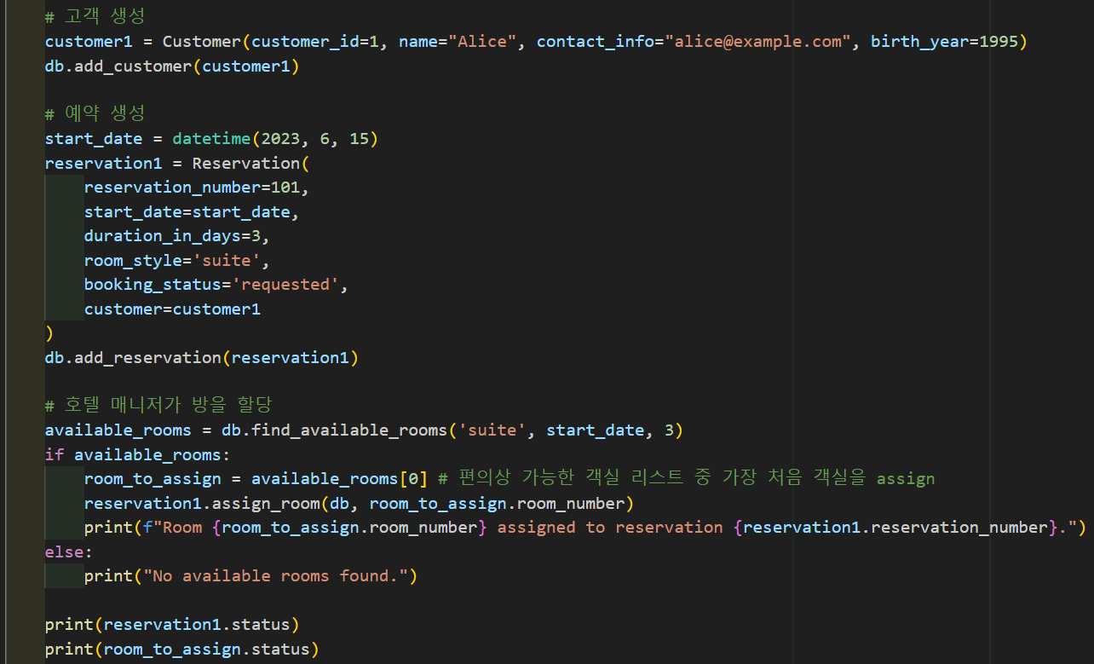
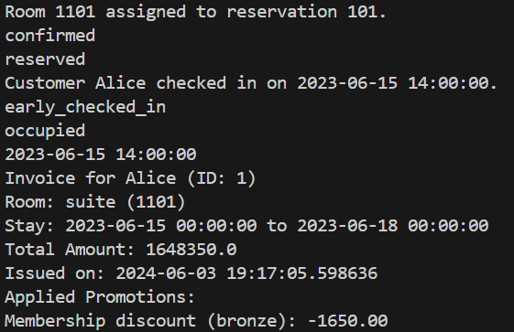
admin_system/ main__.py

Slide 8
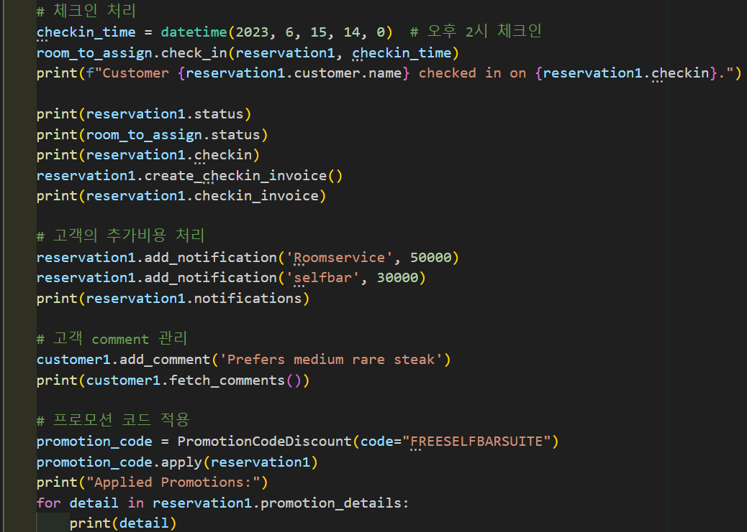
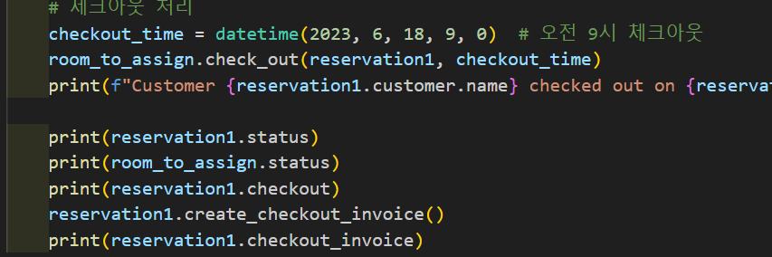
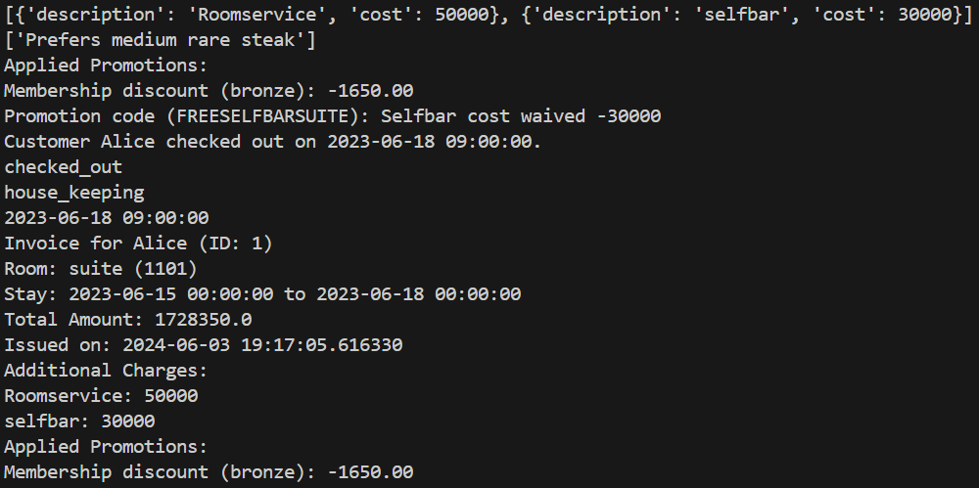
admin_system/ main__.py

Slide 9
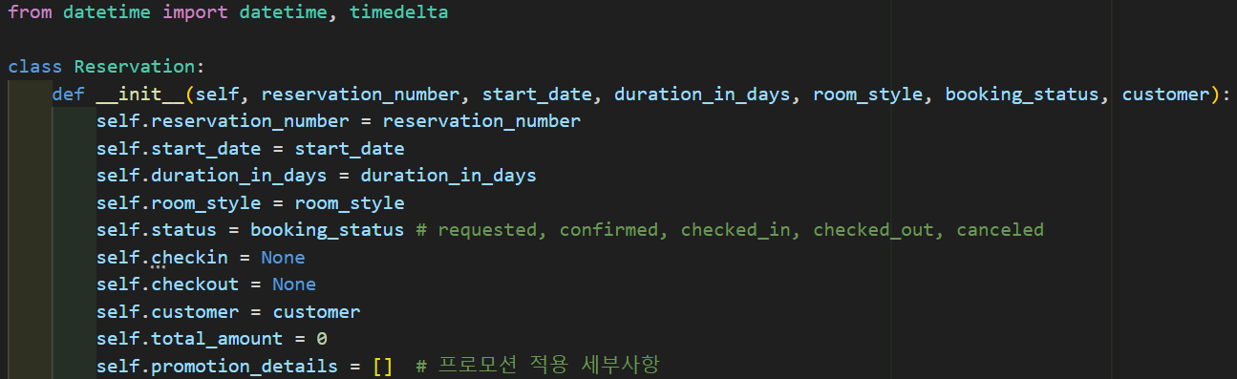
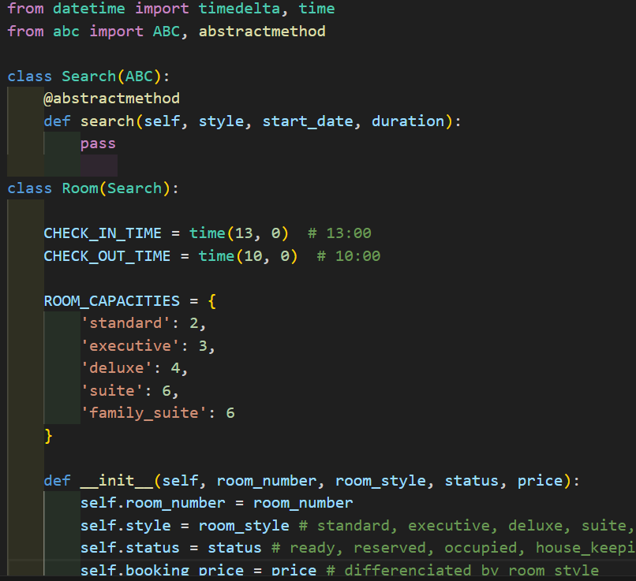
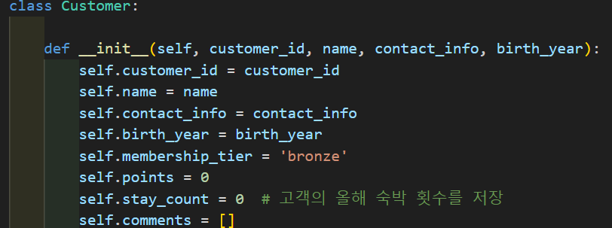
├── customer_system/
│ ├── models/
│ │ ├── customer.py
│ │ ├── reservation.py
│ │ ├── room.py
│ ├── utilities/
│ │ ├── database.py
│ │ ├── promotion.py
│ ├── __main__.py
<reservation.py>
available to check in or not
self check-in
<customer.py>
customer info
<room.py>
customer can check the room which is available

Slide 10
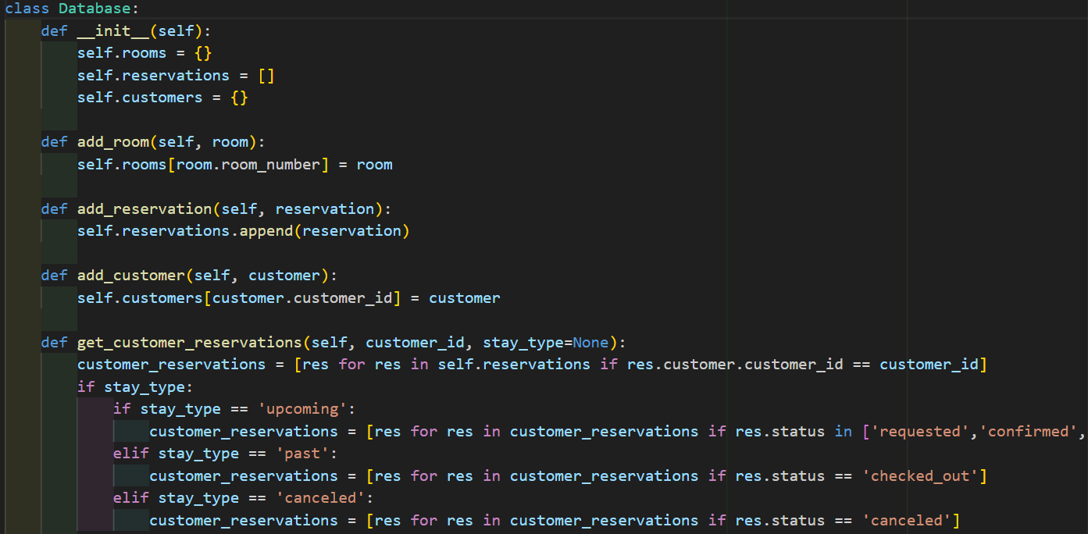
├── customer_system/
│ ├── models/
│ │ ├── customer.py
│ │ ├── reservation.py
│ │ ├── room.py
│ ├── utilities/
│ │ ├── database.py
│ │ ├── promotion.py
│ ├── __main__.py
<database.py>
room, status, customer info… etc
<promotion.py>
1. Membership discount
2. Stay count discount
3. Age discount
4. Promotion code discount

Slide 11
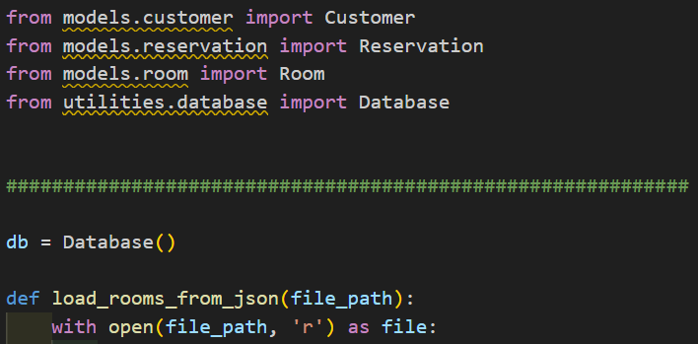
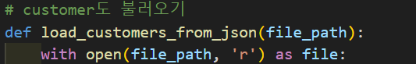
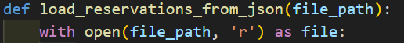
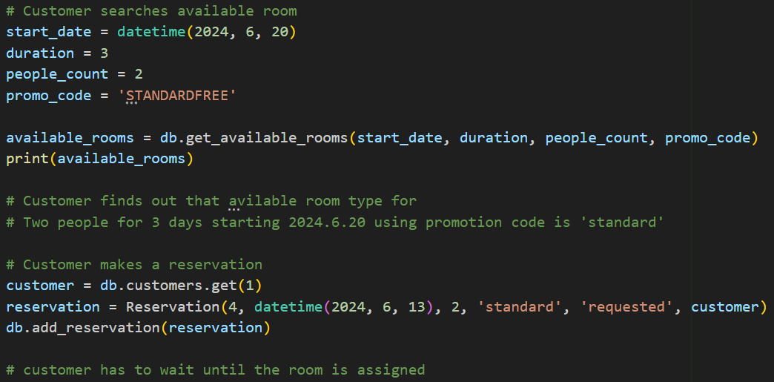
customer_system/main__.py

Slide 12
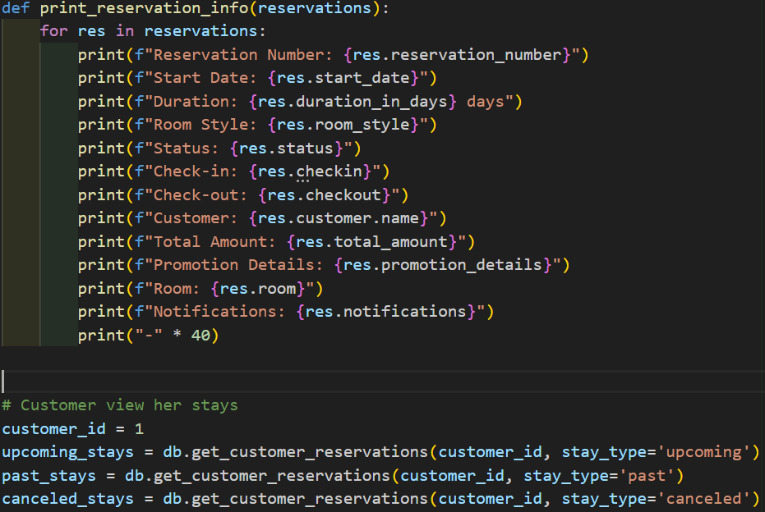
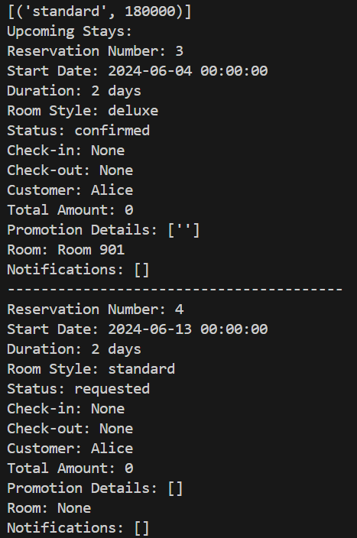
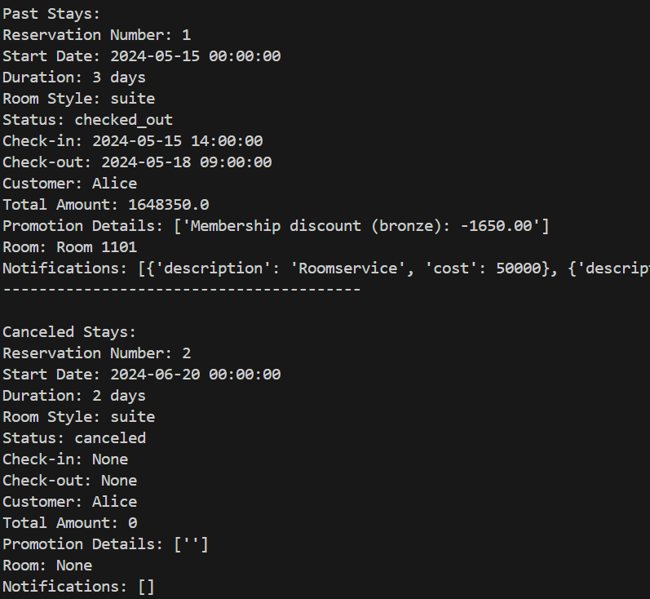
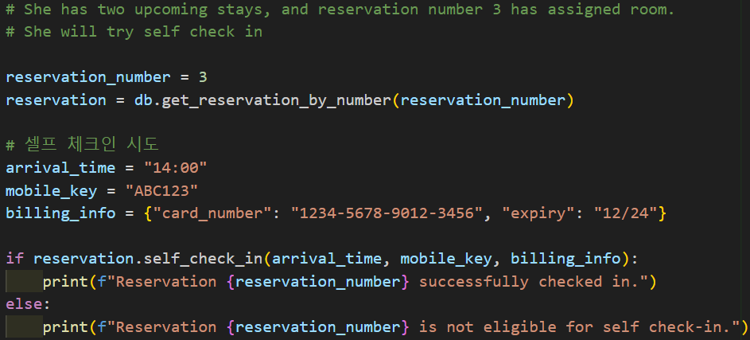
customer_system/main__.py

Slide 13
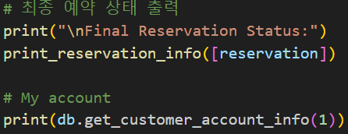
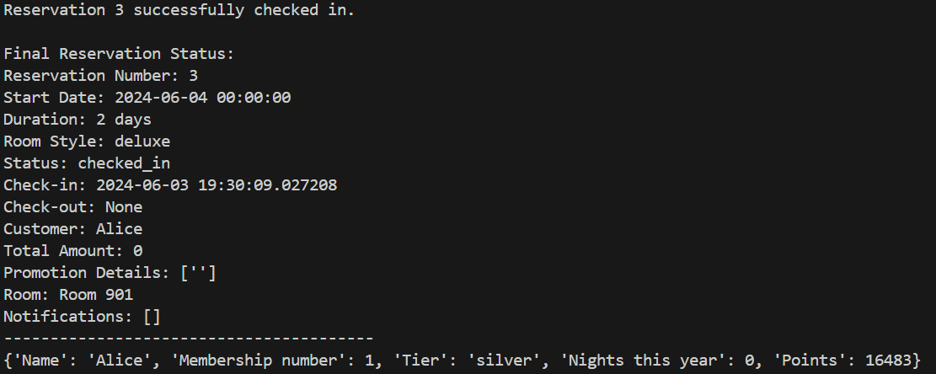
customer_system/main__.py

